Slide 1

WorkKar – A Decentralized Gig Enabler Platform for Blue-Collar Workers
This presentation provides an overview of WorkKar, a decentralized platform designed to empower blue-collar workers in the burgeoning gig economy. We will delve into the platform's core functionalities, technical architecture, and its potential to address existing challenges faced by workers and users alike.
Name: Mohammed Maaz Ali
Roll No.: 1604-22-737-101
College: Muffakham Jah College of Engineering and Technology
Presentation Type: Literature Survey
Event Date: 14th July 2025

Slide 2
Introduction to the Gig Economy and WorkKar
Booming Gig Economy
Challenges for Workers
WorkKar's Solution
The Indian gig economy is experiencing rapid growth, driven by increasing demand for both skilled and unskilled services across urban and semi-urban areas. This expansion presents significant opportunities for a diverse workforce.
Blue-collar workers often face critical issues such as over-reliance on agents, a lack of digital presence for independent outreach, and unfair commission deductions that diminish their earnings.
WorkKar directly addresses these challenges by offering a commission-free, location-based digital platform. It aims to empower workers and provide transparent, affordable services to users.

Slide 3

WorkKar: A Decentralized Approach
WorkKar is a decentralized platform designed to directly connect users with verified blue-collar workers using real-time location. By eliminating intermediaries and commission fees, it ensures workers retain full control over their earnings and services through dedicated dashboards. The platform empowers local workers by providing direct access to clients while offering users affordable, reliable services.

Slide 4

Related Work and Research Gap
Existing Platforms
The WorkKar Advantage
Urban Company: Centralized, high commission, limited worker control.
There is a significant gap in the market for a platform that truly empowers workers with zero commission and efficient local discovery. WorkKar fills this void by offering direct access between users and workers, comprehensive worker dashboards, and robust user/worker verification processes.
Apna: Primarily job listings, no direct service booking functionality.
JustDial: Listing directory, lacks integrated trust and verification features.
Fiverr: Freelance platform, not specifically focused on blue-collar or local, on-demand services.

Slide 5




Problem Statement
Worker Autonomy
Affordability & Transparency
Workers currently lack control over their earnings and service bookings, often dictated by intermediaries.
Users in semi-urban and urban areas need an affordable, transparent platform for reliable services.
Middleman Dependency
Trust & Discovery
Over-reliance on traditional agents or middlemen creates inefficiencies and reduces worker profits.
The current ecosystem lacks verified worker profiles and real-time, location-based service discovery.

Slide 6

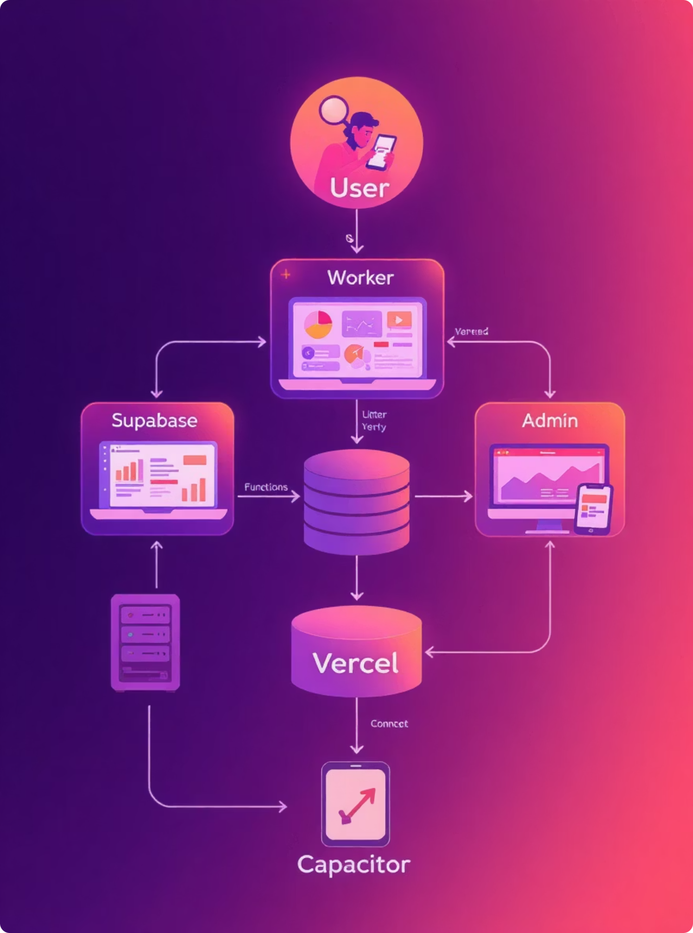
System Architecture & Workflow
WorkKar is designed with a robust role-based architecture, segmenting users into distinct categories: Users, Workers, and Administrators. These roles seamlessly interact with a scalable Supabase backend, which handles data management and authentication. The platform leverages real-time geolocation capabilities to accurately display nearby available workers, facilitating efficient and direct service bookings.

Slide 7
Implementation – Tech Stack
The WorkKar platform is built using a modern and efficient tech stack, chosen for its scalability, performance, and developer experience. Each component plays a crucial role in delivering a seamless user and worker experience.
Frontend
React + TypeScript
Fast, scalable, component-based UI development
Styling
Tailwind CSS
Utility-first, highly customizable, mobile responsive design
Backend
Supabase
Real-time database, open-source, integrated authentication
Mobile
Capacitor
Cross-platform PWA to native Android/iOS bridge
Hosting
Vercel
Serverless deployment, optimized performance, continuous integration

Slide 8





Merits – Benefits of WorkKar
Zero Commission
Verified Profiles
Real-time Matching
Workers retain 100% of their earnings, fostering financial independence.
Ensures trust and reliability through verified and rated worker profiles.
Location-based matching for efficient and rapid service fulfillment.
Dedicated Dashboards
Scalable Architecture
Intuitive dashboards for users, workers, and administrators enhance control.
Modular design supports future growth and feature expansion.

Slide 9

Demerits – Current Limitations
While WorkKar presents a promising solution, it is important to acknowledge its current limitations. These areas are identified for future development and refinement to enhance the platform's robustness and reach.
No Background Verification: Lacks a formal background verification or Know Your Customer (KYC) system for workers, which is crucial for building user trust.
Skill Certification: Does not yet integrate a system for official skill certification, which could further validate worker expertise.
Rural Awareness: Limited awareness and adoption among blue-collar workers in more rural regions due to digital literacy gaps.
Payment System: Currently lacks integrated in-app payment processing or comprehensive transaction record features.

Slide 10
Competitor Comparison Table
Feature
WorkKar
Urban Company
JustDial
Commission-Free
✅
❌
✅ (Partial)
Location-Based Match
✅
✅
❌
Worker Dashboard
✅
❌
❌
Profile Verification
Partial
✅
❌
Self-Employment Focus
✅
❌
❌
This table highlights WorkKar's unique positioning in the market, emphasizing its worker-centric and commission-free model compared to established competitors.

Slide 11
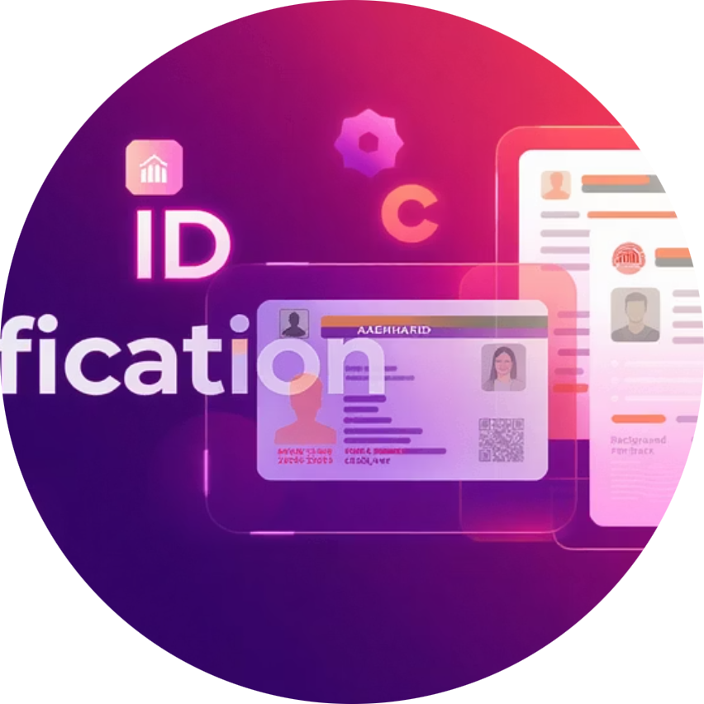
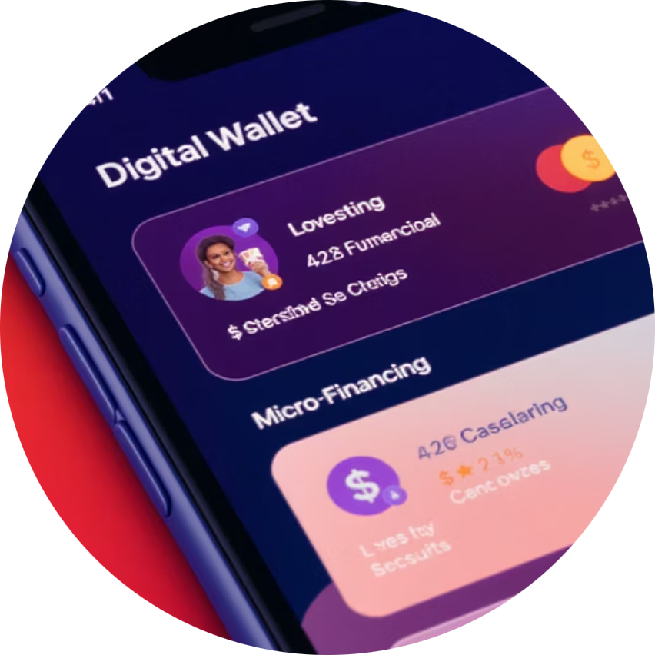

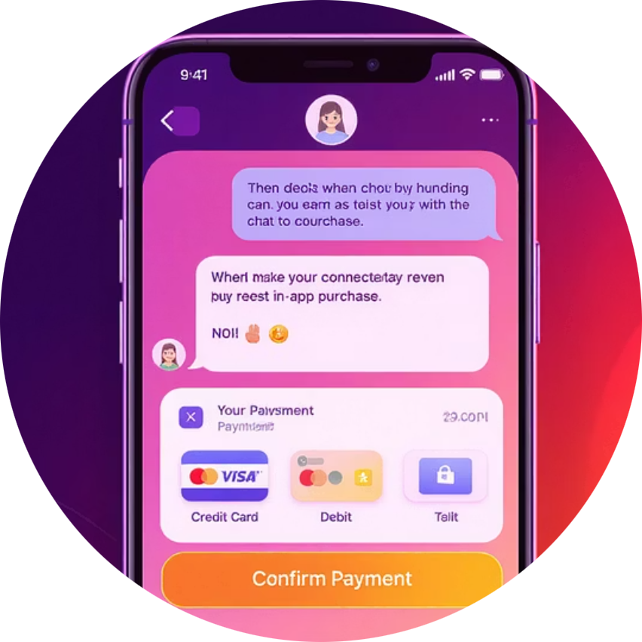

Future Enhancements
WorkKar is continuously evolving to address current limitations and expand its capabilities. These planned enhancements will strengthen the platform's foundation and broaden its impact in the gig economy.
Enhanced Verification
Financial Tools
Skill Certification
Add Aadhaar/ID verification & background checks to build stronger trust and security for all users.
Introduce micro-financing and savings tools for workers to support their financial growth and independence.
Launch government-backed skill certification integration to validate worker expertise and increase credibility.
Seamless Communication
AI-Powered Matching
Add in-app payments and chat support for smoother transactions and enhanced user experience.
Build AI-based job recommendations and scheduling engine for intelligent worker-user matching and optimization.

Slide 12


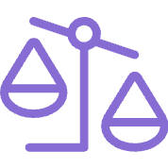

Conclusion
Revolutionizing the Gig Economy
Empowering Workers
WorkKar aims to revolutionize the blue-collar gig economy in India by offering a commission-free, verified, location-driven platform.
It empowers workers and simplifies discovery, creating a direct connection between service providers and users.
Scalable Solution
Future Growth
The platform is scalable across Telangana and beyond, with the potential to expand nationwide.
With future features, WorkKar can grow into a full-fledged public service startup transforming the gig economy landscape.

